Slide 1
TRANSPORT & INTERNATIONAL LOGISTICS
Another vision of transport
Give your goods bodyguards it deserves

Slide 2
WHO ARE WE ?
ISK TRANSIT goals have been focused in delivering personalized service, exceptional quality and superior value to each and every one of our customers. These goals will remain unchanged to the ever transforming environment and market stability.
We are very proud of our flexibility to quickly adapt to our customers changing need. By investing in the best people, the latest technologies and innovative solutions, we are committed to being the strongest link for all of your transportation, distribution and warehousing needs.
We are convinced that a successful organization are built on strong leadership, consistency of purpose, innovation, professionalism, customer focus and result orientation. Our well-trained and experienced employees are our greatest asset. We have a relationship-focused operation offering sound logistic solutions with every client and our team is dedicated to make sure you receive the absolute best service for your logistic needs.

Slide 3
OUR ACTIVITIES
SEA TRANSPORT
LCL and FCL export and import service, transit loads, heavy lifts & break bulk services.
AIR TRANSPORT
Directly to any destination provided a diversion airport with the delivery point
ROAD TRANSPORT
The land Transportation services runs
in France, Europe by
By special vehicles: (van, truck, trailer, high volume) or consolidation vehicle
WAREHOUSE
New and spacious warehouse Electronic Monitoring Storage / Inventory Management Order picking Packaging Shipping

Slide 4
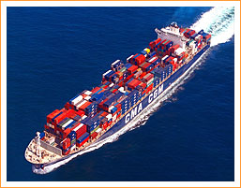
ISK TRANSIT SEA Our Sea transport
For international deliveries where time constraints are not so crucial, sea freight can offer a cost effective alternative to air freight.
Shipping cargo by sea requires a lot of expertise. Looking at the best option, taking into consideration multiple aspects of shipping and finding the best and most economical way for our customers. However, navigating among the numerous shipping companies and the different regulations for each country and port can be complex and time consuming. The cultivation of long-term, secure partnerships with major shipping lines bringing tan gable benefits to our customers means we have reliable links to all commercial centers worldwide; which is why our Sea Freight services are among the best in the marketplace.

Slide 5
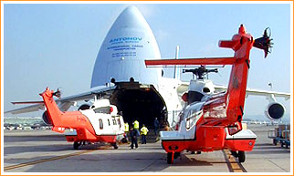
ISK TRANSIT AIR Our Air transport
For urgent consignments air freight is often the most appropriate method of delivery.
Shipping goods by air indeed offers fast service, but large carriers can be impersonal, and many freight forwarders cannot offer you the specialized services that you need to complete your shipment.
We can provide the extras you need to serve your own customers such as :
* proper packaging for safe shipment by air
* clearing customs at destination
* delivery from the receiving airport to the final destination
* and most importantly gaining the clients confidence with reliability and speed of delivery
You can learn more about airfreight shipping by contacting our team directly.

Slide 6
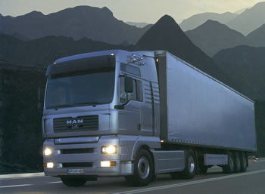
ISK TRANSIT ROAD Our Road transport
Our Transport Management division ensures the efficient transport of our customers goods at import / export.
By complete truck or consolidation we offer :
* Chartering National & International
* Emergency Management full of our customers
* Establishment of international transport loops sites JAT
* Establishment of Milk Run
* Establishment of cross dock

Slide 7
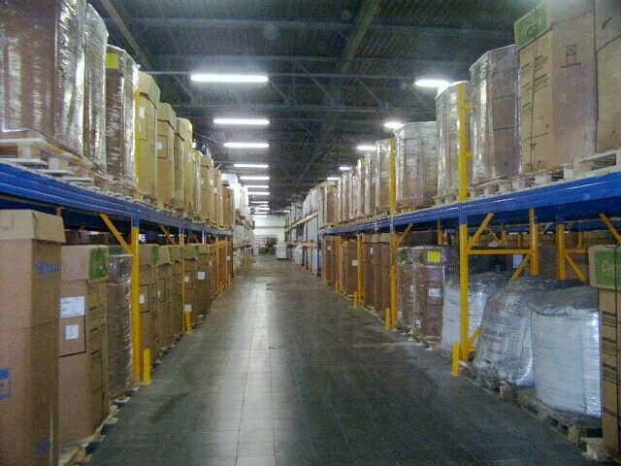
ISK TRANSIT LOGISTICS Our Logistics
Consolidation Cross Dock and Distribution Platform
We have warehouse at Orly and Roissy CDG where we offer a four logistics and distribution services can be customized to suit your specific requirements.
Warehousing is more than placing your goods in a box in a big room, it requires : * Safely handling and storing * Proper packing and unpacking * Controlled access and * Knowing where it is * Properly preparing for onward shipping
Our warehouses, near all the Major port throughout the world.
Cargo of any type can be properly prepared for storage with stuffing, stripping and handling services, then readied for shipment with proper lashing and securing.

Slide 8
CONTACT US
ISK TRANSIT
16 Rue du Trait d’Union
Bat 3700 CARGO 2
BP 19441 Tremblay en France
95707 Roissy CDG
Tél : + 33 (0) 1.49.47.77.86
Fax : + 33(0) 9.70.62.30.02
E-Mail : contact@isk.fr

